Slide 1
Dynamic & Temporal Embeddings
Yavuz Nuzumlali

Slide 2
Outline
Recap for word embeddings
Examples (words, documents, medical concepts, patients etc.)
Limitations
Dynamic embeddings
Examples of dynamic embeddings
Papers 1-4
Conclusion
Discussion for class

Slide 3
Quick Recap for Word Embeddings

Slide 4
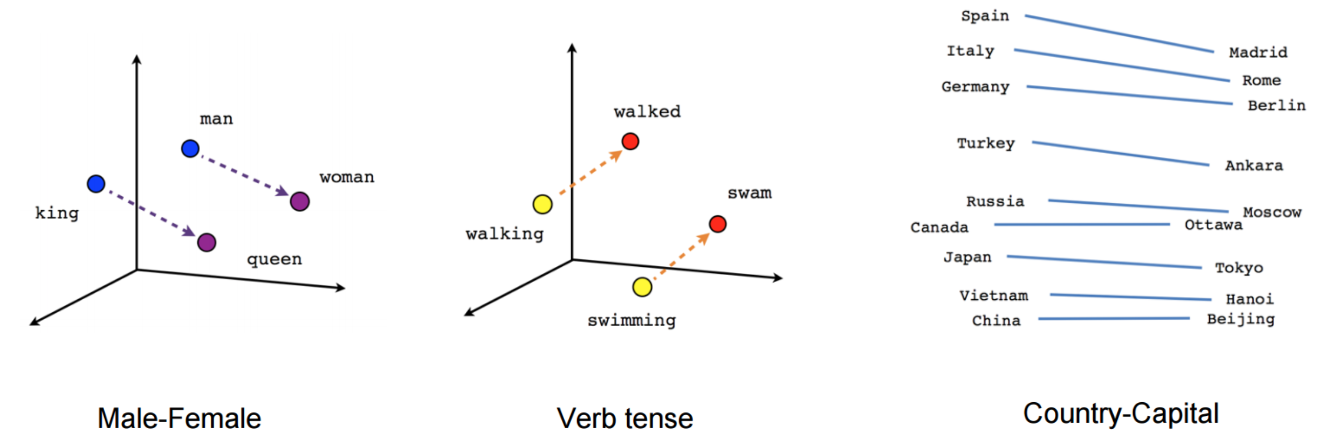
Word Embeddings
Represent words in a common vector space!

Slide 5
Examples (*2vec)

Slide 6
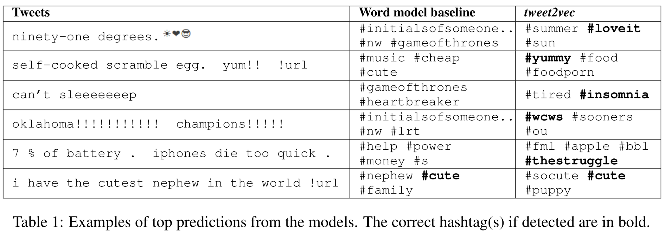
Tweet2Vec: Character-Based Distributed Representations for Social Media (Dhingra et al., ACL, 2016)

Slide 7
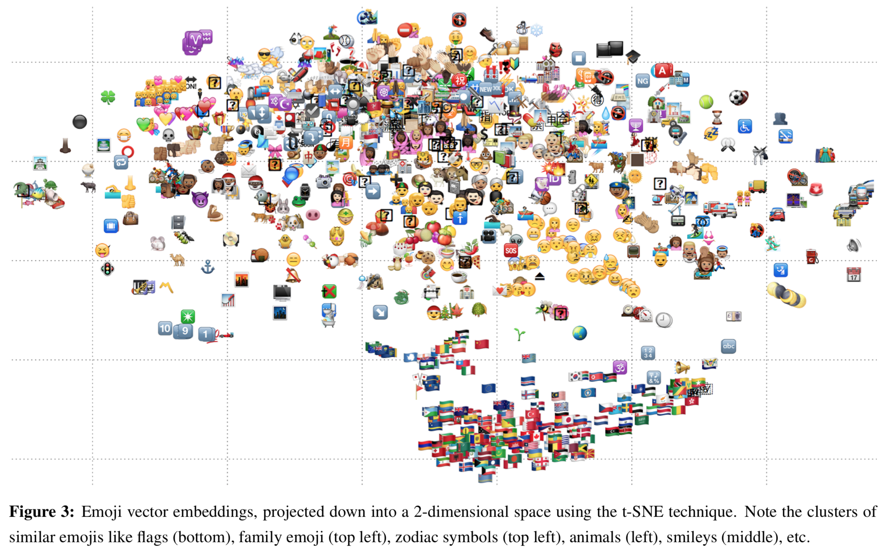
emoji2vec: Learning Emoji Representations from their Description (Eisner et al., EMNLP, 2016)

Slide 8
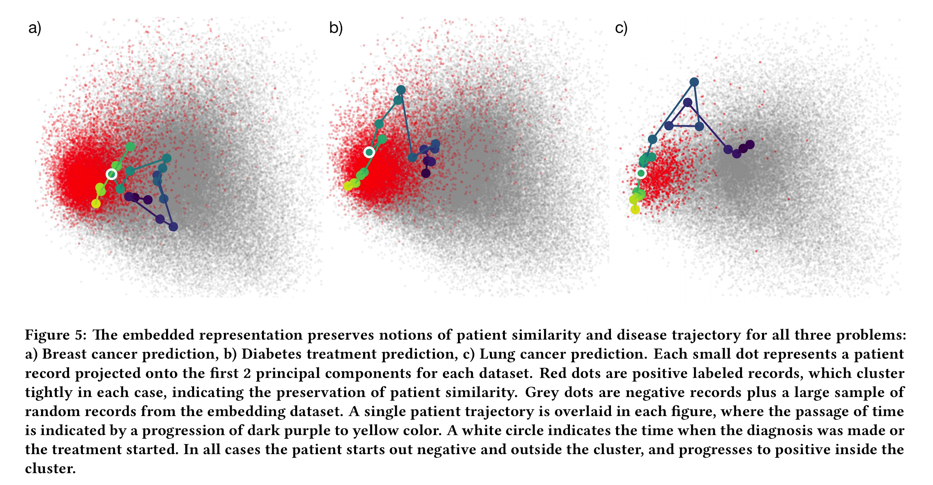
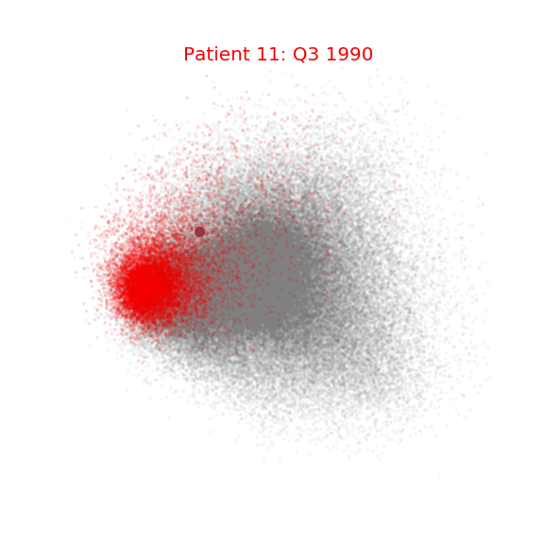
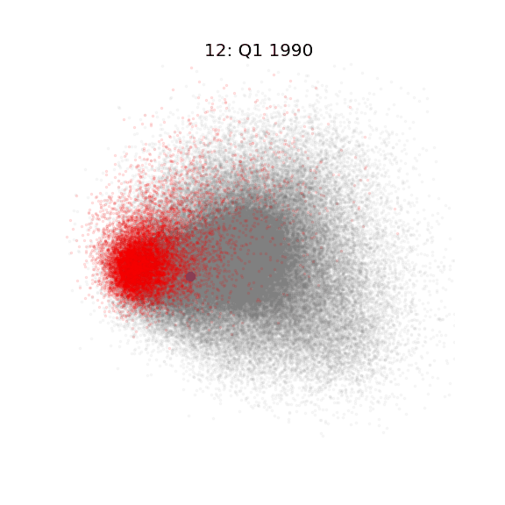
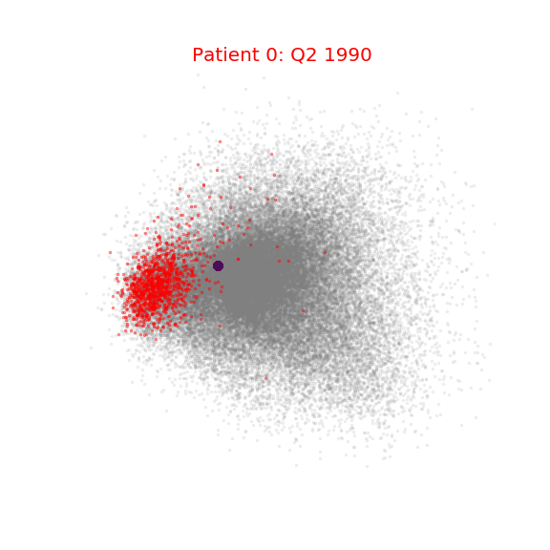
patient2vec: Embedding Complexity In the Data Representation Instead of In the Model(Bajor et al., KDD, 2018)

Slide 9
Limitations
Polysemy
Each token may only have 1 vector representation
Does not build multiple representations according to context
Averages over all possible meanings, which may cause dramatic shifts in vector space
Semantic changes over time
Each token may only have 1 vector representation
Ignores words’ diachronic semantic shift behavior
Other types of entities may have much more dynamic changes
Does not build multiple representations for tokens over time.
Averages over all meaning through history, which may cause dramatic shifts in vector space

Slide 10
Dynamic/Temporal Embeddings

Slide 11
Motivation
Encode temporal dynamics of the entities while learning embeddings
Different kinds of temporalities:
Meaning of a word may change over years
‘obama’ was very similar to ‘president’ for a long time, not anymore, not before 2009
Emerging words such as ‘hashtag’ after social media
“Hangry”, “defriend” https://www.ted.com/talks/anne_curzan_what_makes_a_word_real?utm_campaign=tedspread&utm_medium=referral&utm_source=tedcomshare
Some other entities inherently have temporal features which directly define semantics
Patients: They may be sick before and well now, or vice versa.
Time series(Stocks): One may perform well for a long-time then plunge, or opposite.
How to model temporal patterns if you want low-dimensional vectors?

Slide 12
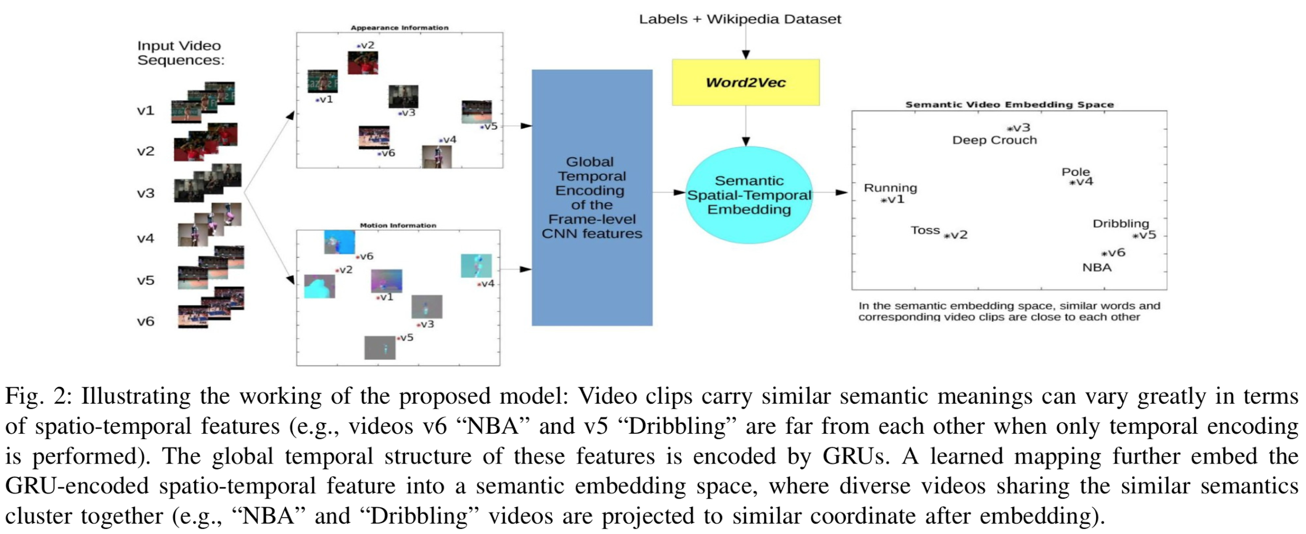
Video2vec: Learning Semantic Spatio-Temporal Embeddings for Video Representation(Hu et al., ICPR, 2016)

Slide 13
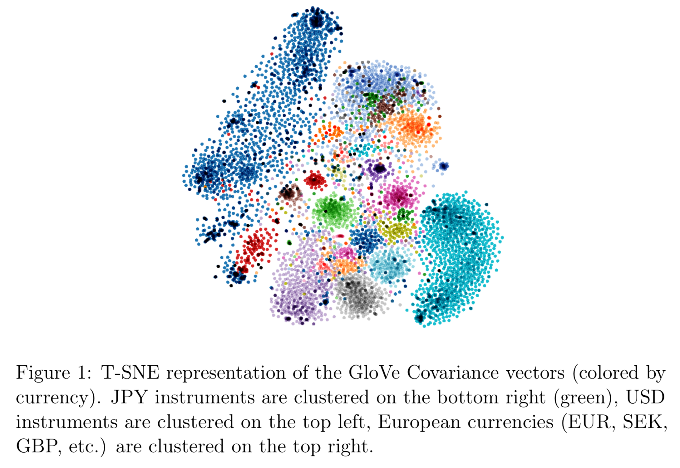
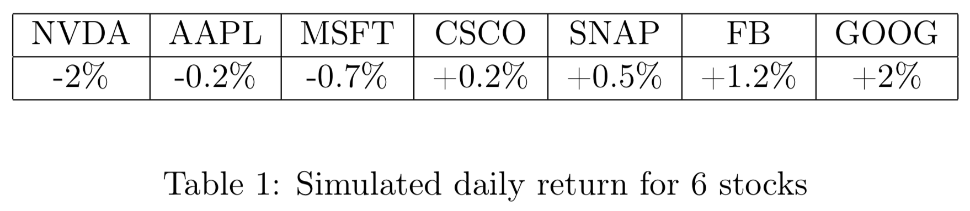
From Word to Financial Time Series Embedding( De Bruyn, SSRN, 2018)

Slide 14
Paper Time

Slide 15
Diachronic Word Embeddings Reveal
Statistical Laws of Semantic Change
William L. Hamilton, Jure Leskovec, Dan Jurafsky (ACL, 2016)

Slide 16
Motivation
Word embedding techniques does not model semantic changes of words over time
Can cause distortion if model is trained on documents from a very wide range of time.
Called as HistWords

Slide 17
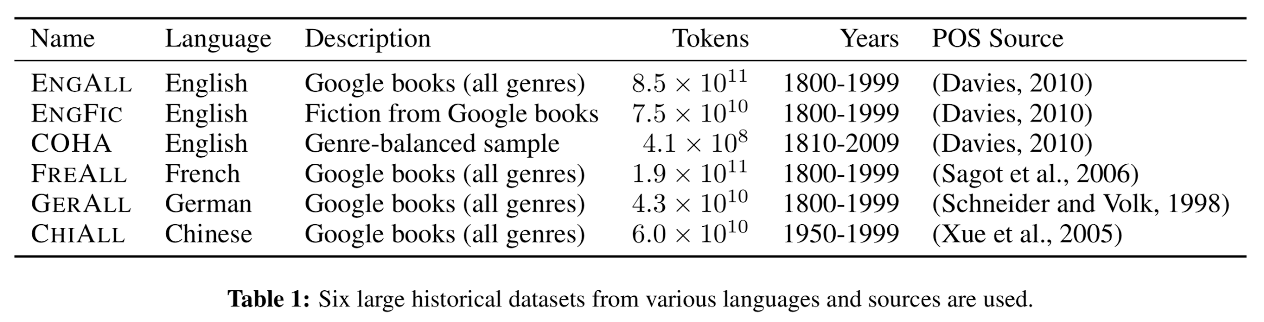
Data
6 corpora spanning 200 years & 4 languages
English, German, French, Chinese

Slide 18
Methodology
Use & evaluate existing word embedding methods
PPMI, SVD, word2vec
Train separate embeddings for each decade
Align embeddings into a common vector space
Use it to quantify semantic similarity between pairs of words through time, and semantic drift of a particular word through time.
Analyze and evaluate expressiveness of the model
Verify known shifts
Discover unknown interesting shift patterns from data

Slide 19
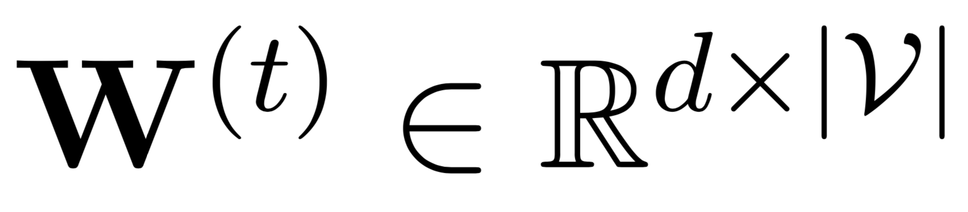
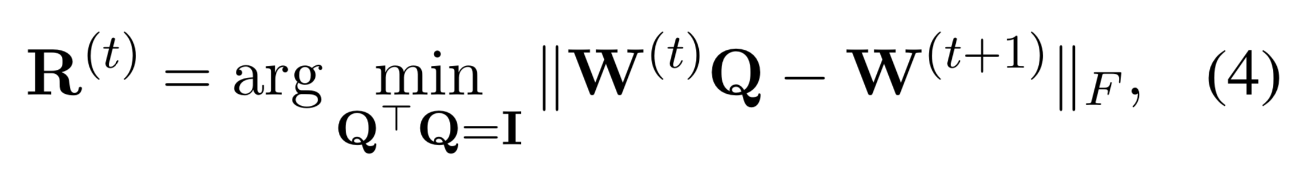
Alignment of periodical embeddings
Orthogonal Procrustes
: Learned matrix of word embeddings for time period t
Optimize following objective:
Solution corresponds to best rotational alignment, solved by SVD

Slide 20
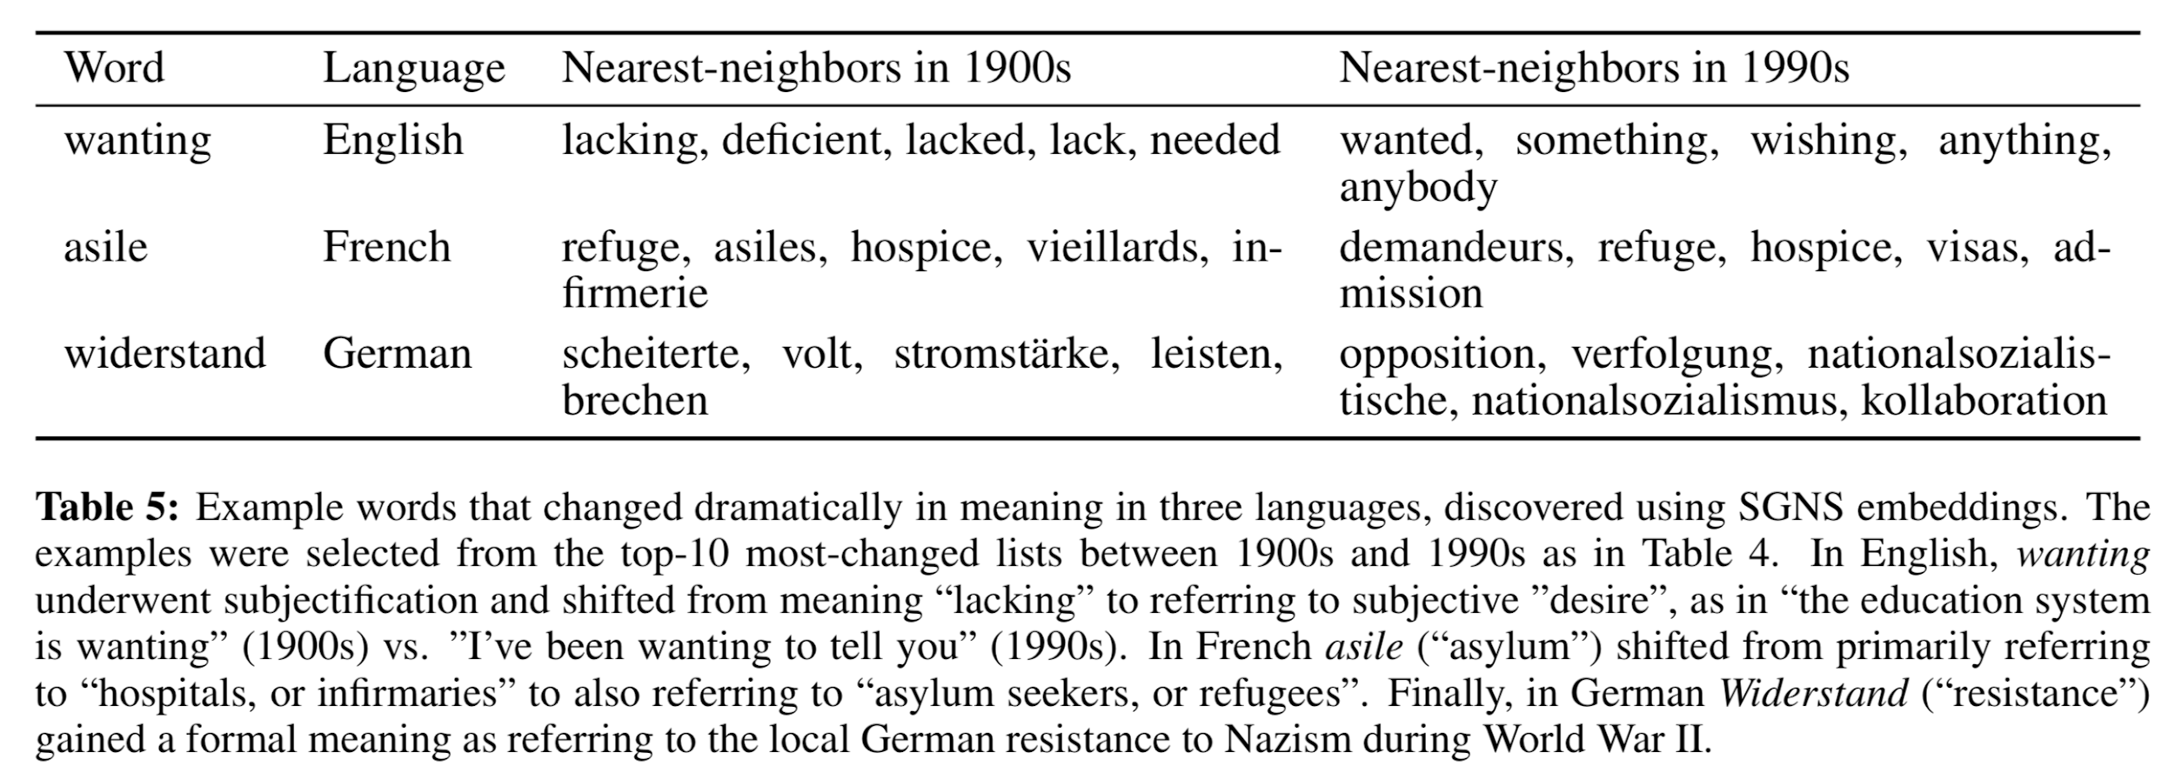
Results

Slide 21
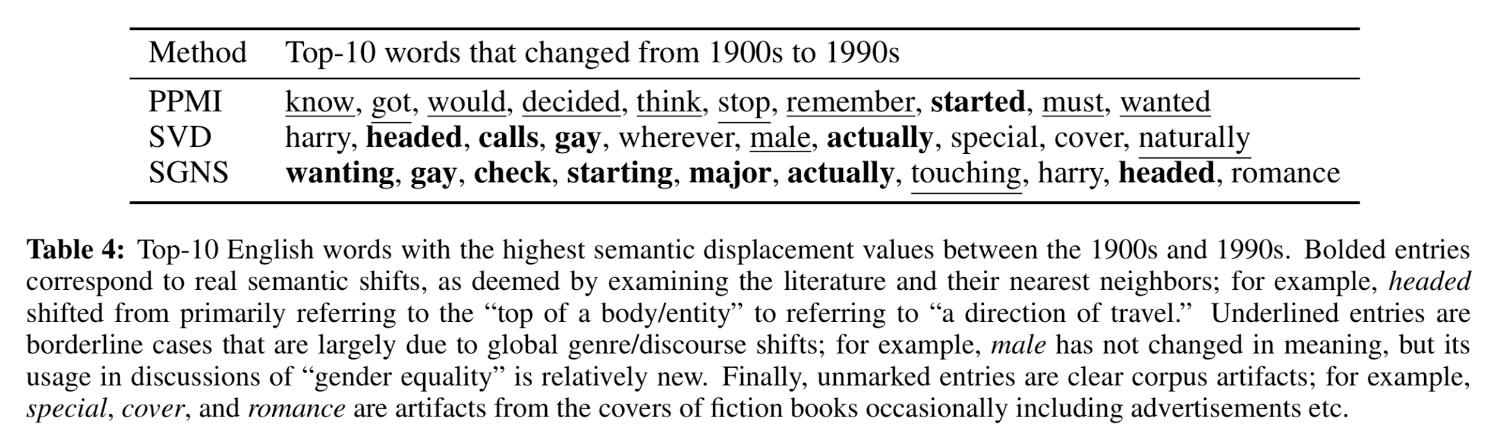
Results

Slide 22
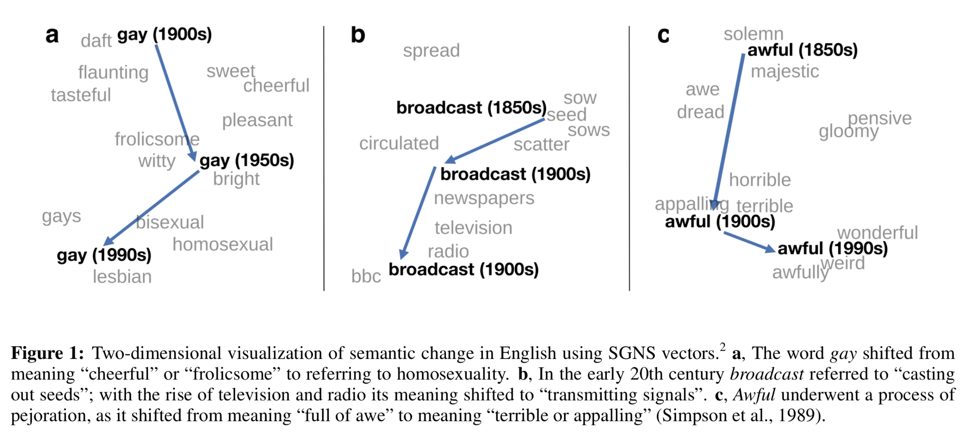
Semantic changes

Slide 23
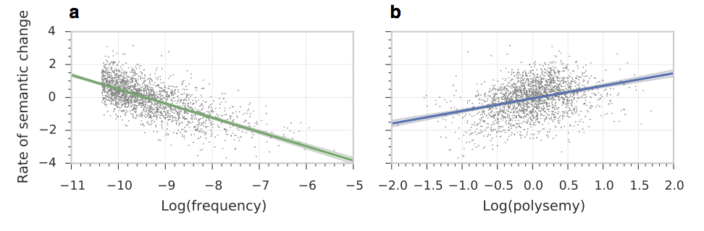
The Law of Conformity
High-frequency words change less􏰍

Slide 24
The Law of Innovation
Polysemous words change faster

Slide 25
Discussion
Comprehensive analysis on word embedding methods’ expressive power in terms of semantic similarities
Proposes a vector space alignment approach for embeddings over time periods to model diachronic behavior of words
Limitations
Has to learn separate embeddings for each predetermined time slice
Requires enough data in each time slice
Required specific alignment step to put vectors into same space

Slide 26
Predictive Effects of Novelty Measured by Temporal Embeddings on the Growth of Scientific Literature
Jiangen He, Chaomei Chen
(Frontiers in Research Metrics and Analytics, 2018)

Slide 27
Motivation
Previous research on novelty detection mainly uses bibliometrics & citation analysis
Requires time to pass until links establish
Retrospective analysis rather than predictive
Instead, model novelty by looking into semantic change of terms over time
Use temporal word embeddings!
What’s novelty?
“The measure of how much new scientific knowledge was produced by the scientific community and characterized by scientific literature on the research topic in a specific period.”

Slide 28
Data
MEDLINE/PubMed
26M journal citations and abstracts for biomedical literature
Use titles and abstracts
Have indexes from Medical Subject Headings (MeSH)
Basic preprocessing
Phrase removal using MeSH (e.g. 9 phrasal synonyms of “HIV” => “HIV_Antibodies”)
Abbreviation expansion (e.g. EPA => Environmentz_Protection_Agency)

Slide 29
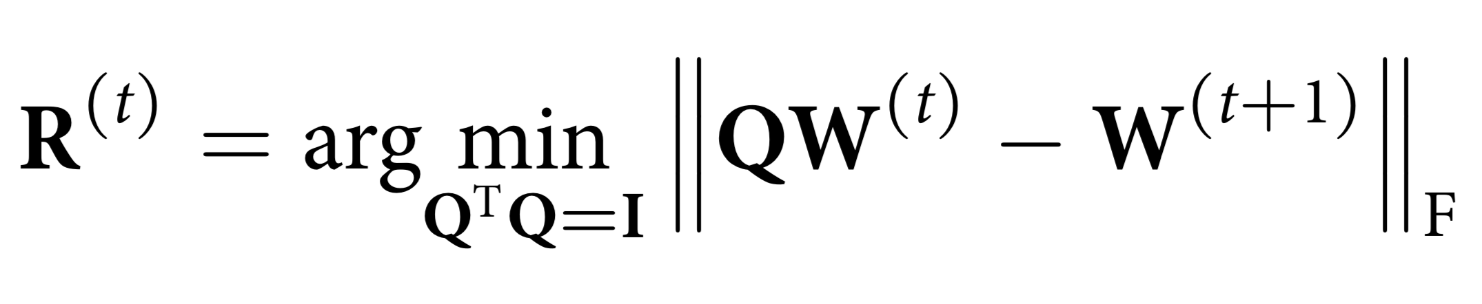
Methodology
word2vec to build word embeddings per each year
dim=100, window=5, neg_sample=5, epochs=5
HistWords for temporal alignment
Novelty measure

Slide 30
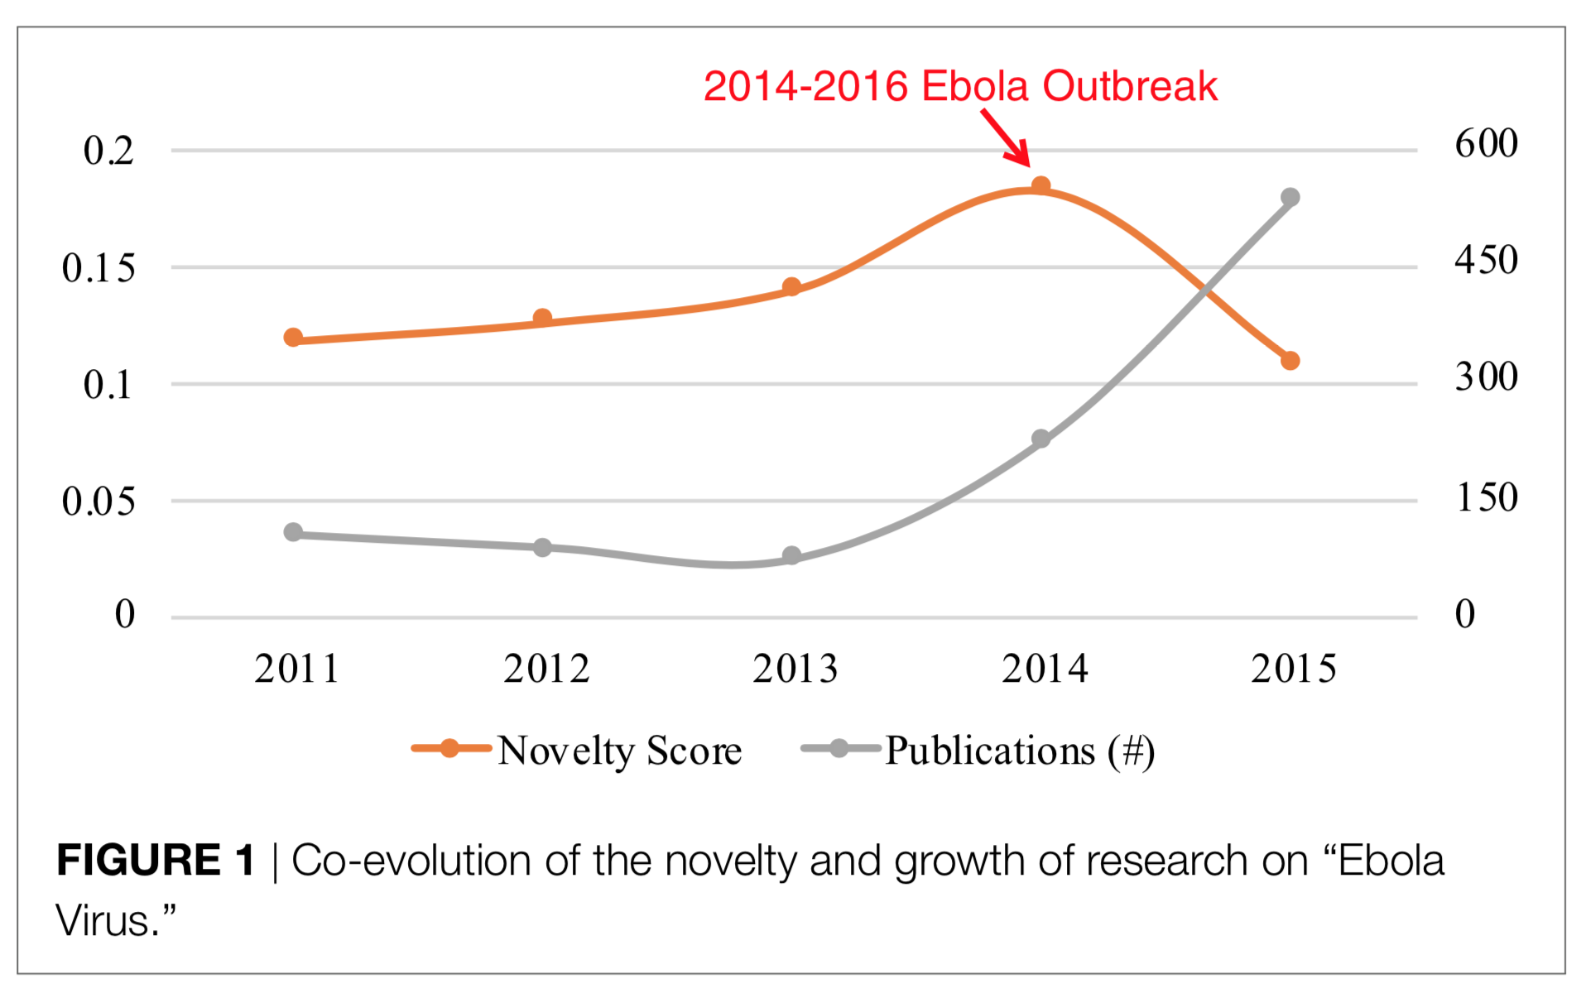
Results: Ebola Virus
Notes:
Ebola virus disease is a severe, often fatal illness in human. It first appeared in 1979 in 2 simultaneous outbreaks in African countries. The 2014–2016 outbreak in West Africa was the largest and most complex outbreak since its discovery (World Health Organization, 2017). We chose research on Ebola Virus from 2011 to 2015 as the example topic.
Figure 1 shows the novelty and growth co-evolution of research on Ebola Virus from 2011 to 2015. From Figure 1, we can see the relatively high novelty of research on Ebola Virus in 2013 and 2014 was followed by the rapid growth in 2014 and 2015. Following the growth in 2014 and 2015, the novelty decreased in 2015. The co-evolving pattern of growth and novelty is in line with the pre- emergence and emergence stages described at the beginning of this article.

Slide 31
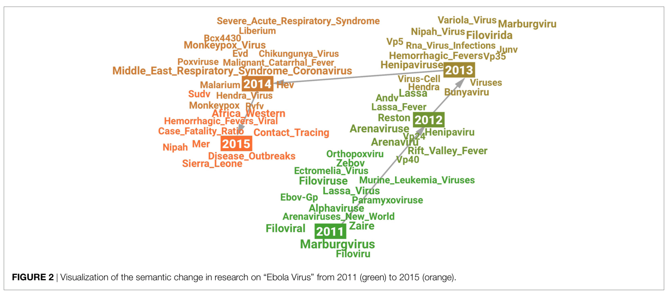
Results: Ebola Virus

Slide 32
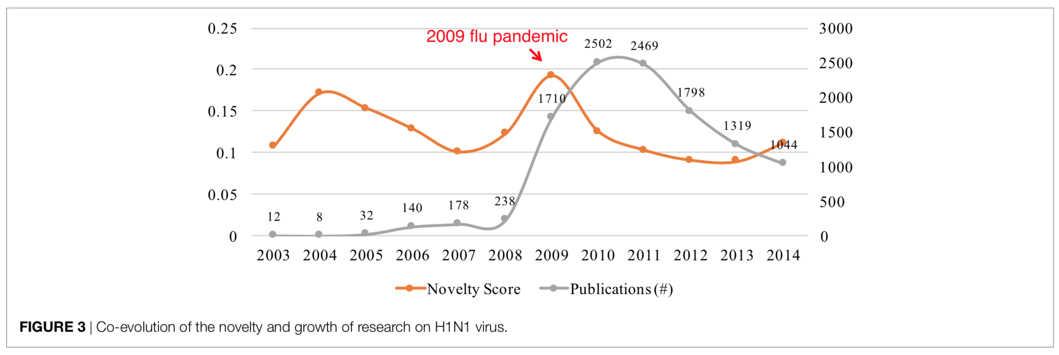
Results: H1N1 Virus
Notes:
Influenza A (H1N1) virus is the subtype of influenza A virus that was the most common cause of 2009 flu pandemic. We chose the research on H1N1 from 2003 to 2014 as the example of this case study.
Figure 3 shows the changes of novelty and publication growth in research on the H1N1 virus from 2003 to 2014. The temporal patterns of novelty and growth are more complex than the case of Ebola virus. We can see two peaks of novelty in 2004 and 2009, respectively. Both peaks of novelty were followed by the rapid growth of publications that occurred in the periods from 2006 to 2008 and from 2009 to 2010, respectively. However, the temporal patterns of these two pairs of novelty-growth relationships were different. The rapid growth from 2006 to 2008 was observed
2 years after the novelty peak in 2004, but the growth spurt in 2009 occurred in the same year as the novelty peak in 2009. The difference may be caused by the global breakout of the 2009 Flu Pandemic (Wikipedia, 2017). Due to this notable social factor, we observed both of growth and novelty spurt in the same year of 2009.

Slide 33
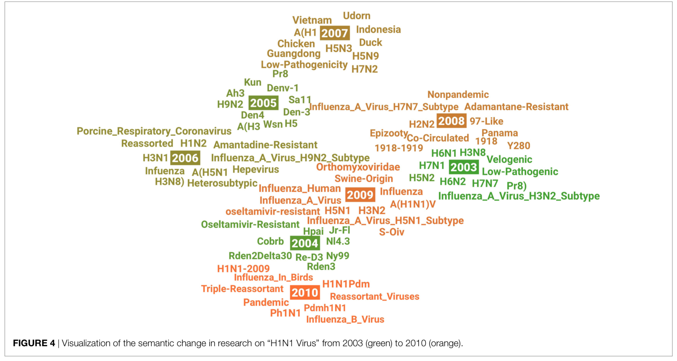
Results: H1N1 Virus
Notes:
The visualization in Figure 4 shows the evolution of research on H1N1 virus from 2003 to 2014. We can observe three common features across these years: (a) many other subtypes of influenza virus A appeared in different years which might indicate related research interests in this area emerged, such as H6N2 in 2003, H9N2 in 2005, and H3N2 in 2009; (b) several geographical terms were highlighted in different year because this research area is usually motivated by the breakouts of H1N1 virus in specific places, such as Guangdong in 2007 and Panama in 2008; and (c) the origination of virus was a constantly investigated research question according to the animal-related terms in different years, such as Duck in 2007 and Swine-Origin in 2009.
By analyzing the terms in 2004 and 2009, we may learn some ideas about the novelty. For example, Swine-Origin and S-OIV in 2009 may indicate research on a new swine-origin influenza A (H1N1) virus (S-OIV) emerged in North America in early 2009 (Smith et al., 2009). As another interesting example, we see the term of oseltamivir-resistant both in 2004 and 2009, which means research activities on oseltamivir-resistant and H1N1 were active but in a different research context in these 2 years, according to our visualization method introduced at the beginning of this section. In 2004, although one patient with oseltamivir-resistant novel H1N1 was identified in Denmark, this did not change the recom- mendations, made by the U.S. Centers for Disease Control and Prevention (CDC), on using oseltamivir on antiviral treatment of influenza A (Tucker, 2004). However, oseltamivir resistance increased significantly for the first time worldwide during the 2007–2008 influenza season (Dharan et al., 2009). This change of antiviral drug resistance patterns might have also greatly changed research on the H1N1 virus in 2009, so we see oseltamivir-resistant reemerged in a new context in 2009.

Slide 34
Discussion
Detailed quantitative analysis shows that;
Their model can’t explain much of the relation between novelty and growth
Novelty can only predict growth over long periods of time (t > 4)
“May be because knowledge diffusion in scientific communities takes time”
The temporal patterns of growth and novelty in science are profoundly complex.
Hard to explain all dynamics with such model.

Slide 35
Dynamic Embeddings for Language Evolution
Maja Rudolph, David Blei (WWW, 2018)

Slide 36
Motivation
Capture how meaning of words change over time
Analyze long-running texts (documents spanning many years) where the usage of words can change over time.
Goal: Detect and characterize these changes
Previous work train independent embeddings from scratch for each time slice
This model can learn probabilistically dependent embedding vectors for each time slice in a single training procedure.
Can model the fact that meanings of words gradually changes over time, rather than having instant significant shifts
Via a Gaussian Random Walk Prior

Slide 37
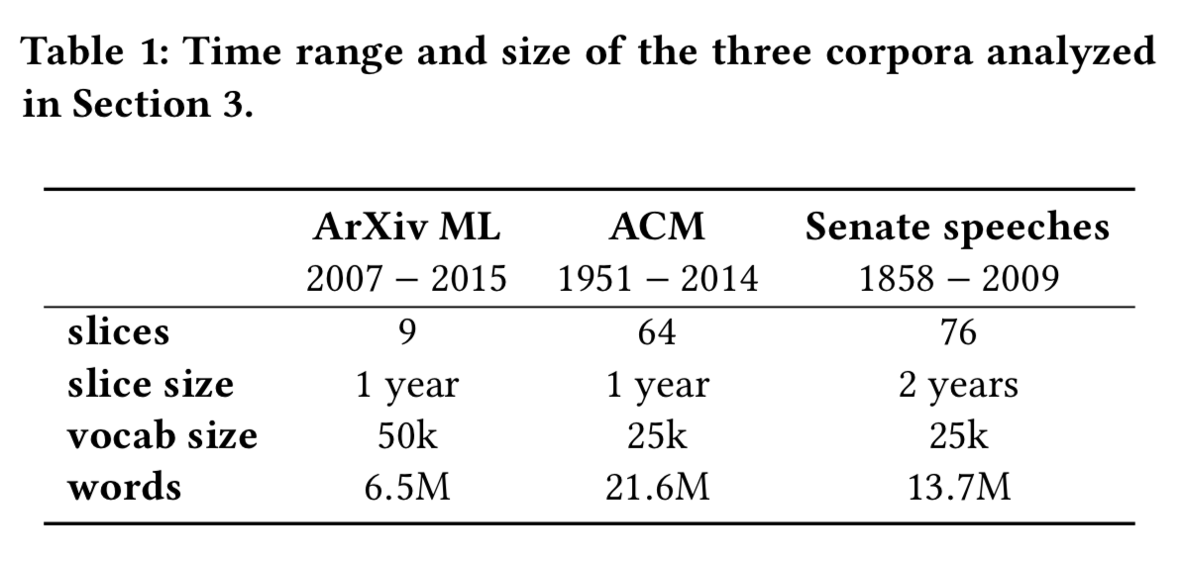
Data

Slide 38
Methodology
Based on exponential family embeddings, which is a probabilistic model
Learn different embedding vectors per each time slice
Learn a shared context vector through whole time period
Use Gaussian Random Walk Prior to model smooth dynamism behavior

Slide 39
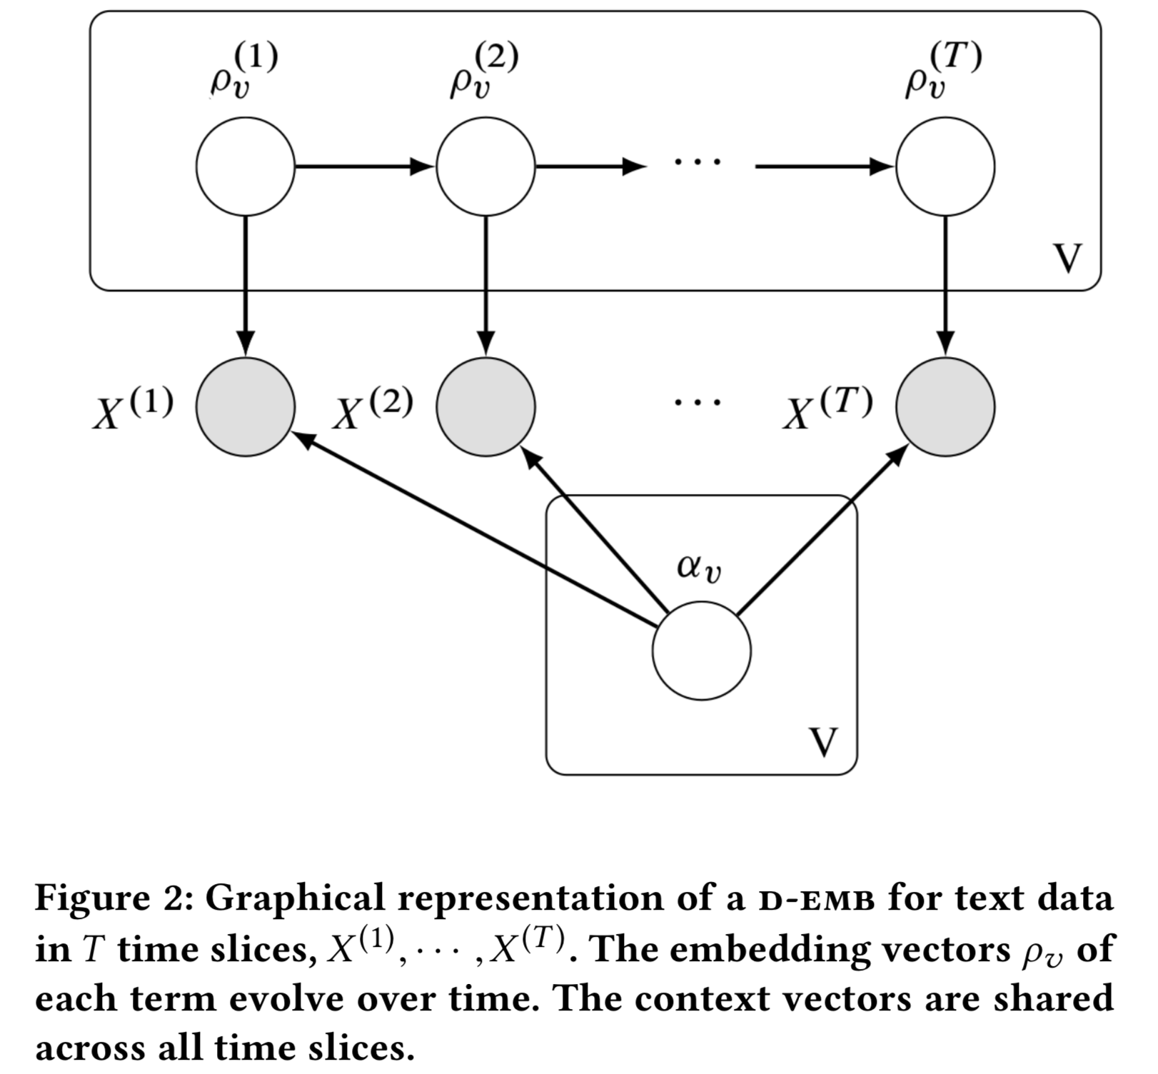
Model

Slide 40
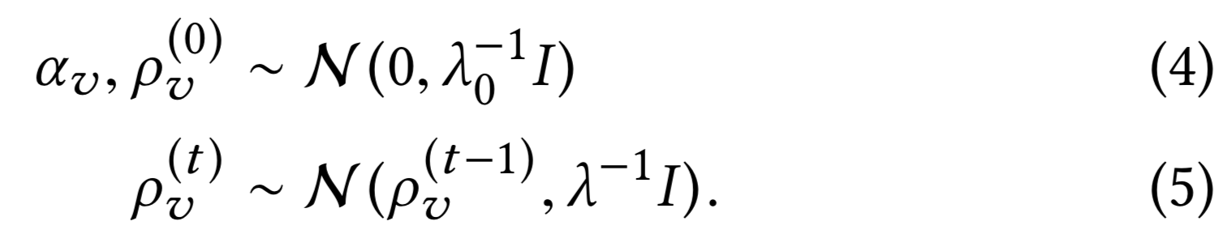
Gaussian Random Walk
As a prior on the embedding vectors
Given data, this leads to smoothly changing estimates of each term’s embedding.

Slide 41
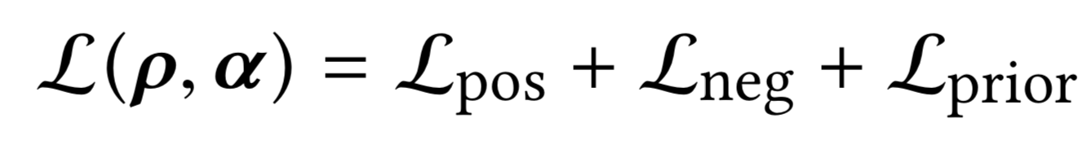
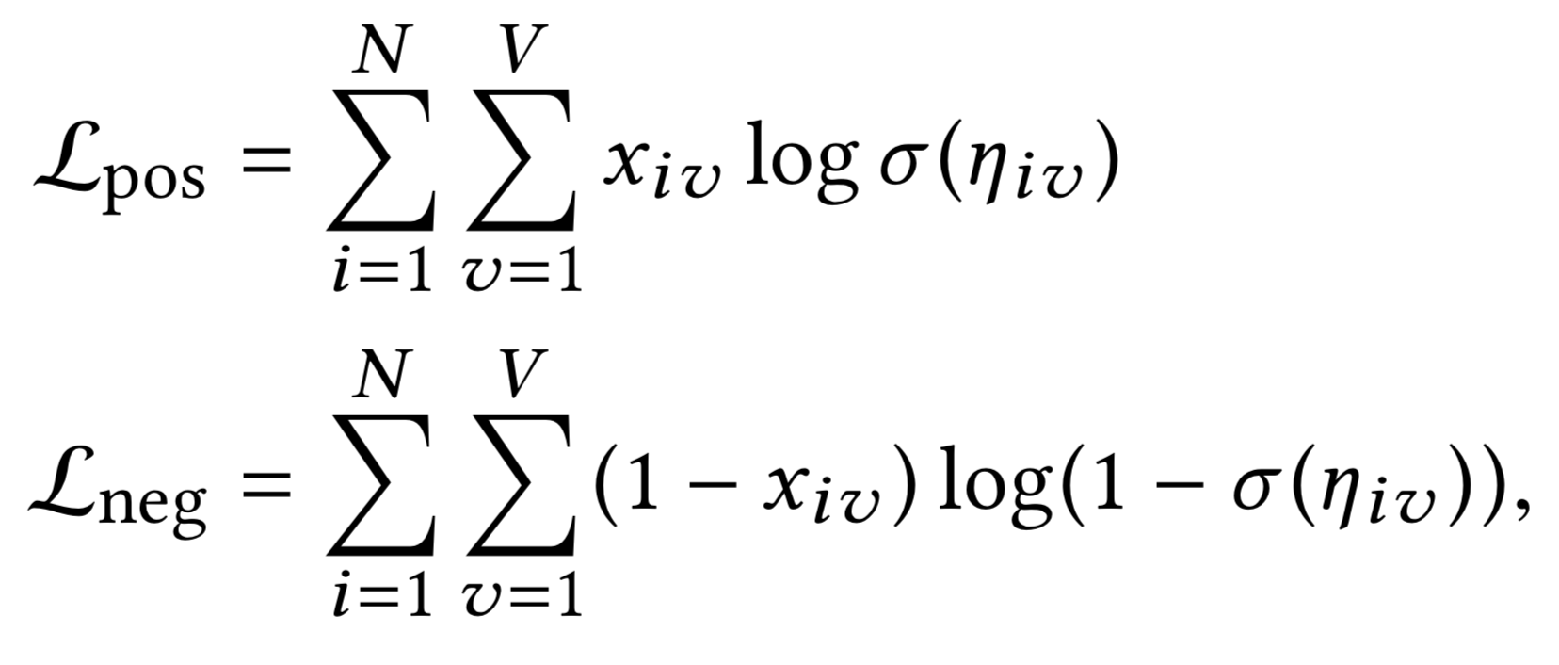
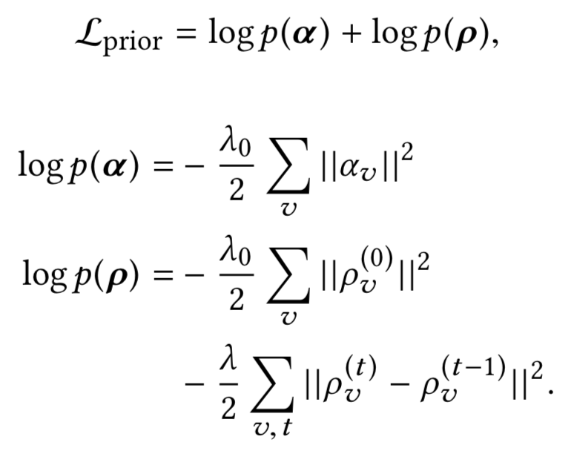
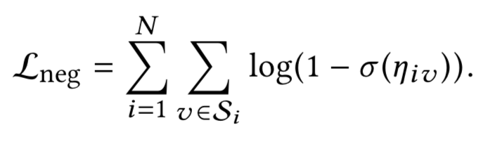
Optimization
Calculating joint likelihood is intractable
Instead, calculate pseudo log likelihood, sum of log conditionals
Commonly used objective for conditional models

Slide 42
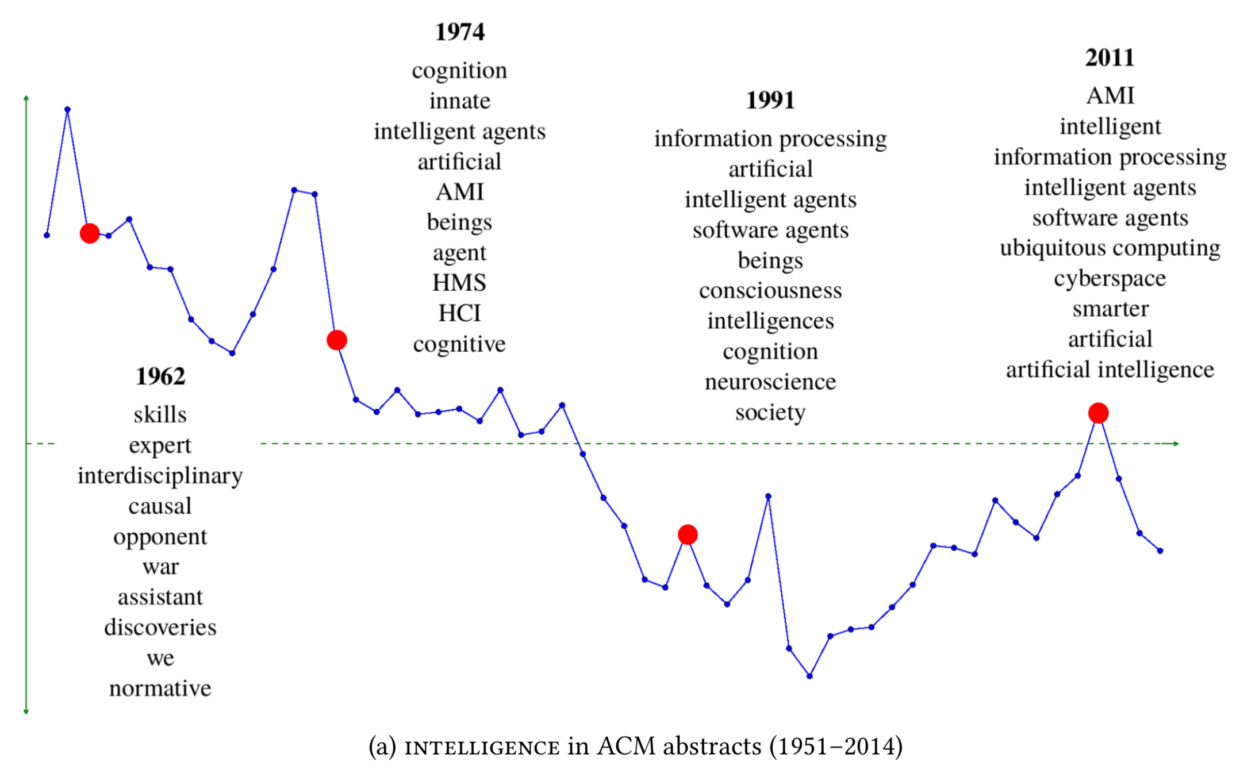
Results

Slide 43
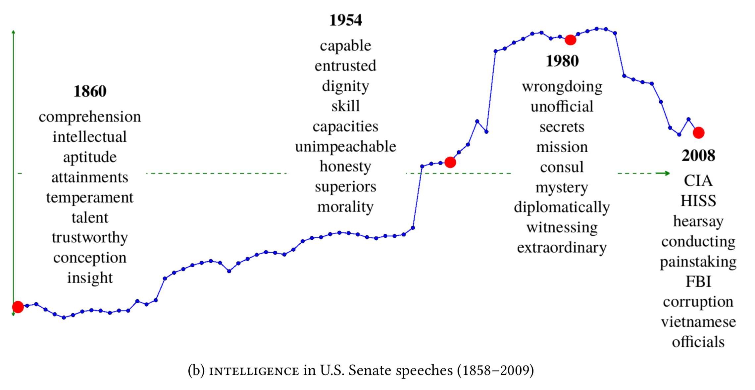
Results

Slide 44
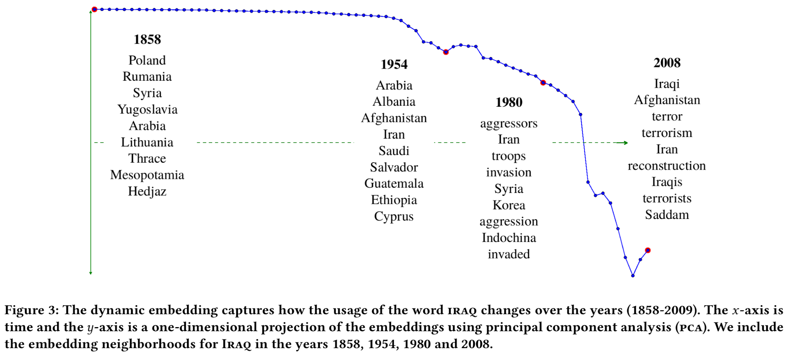
Results

Slide 45
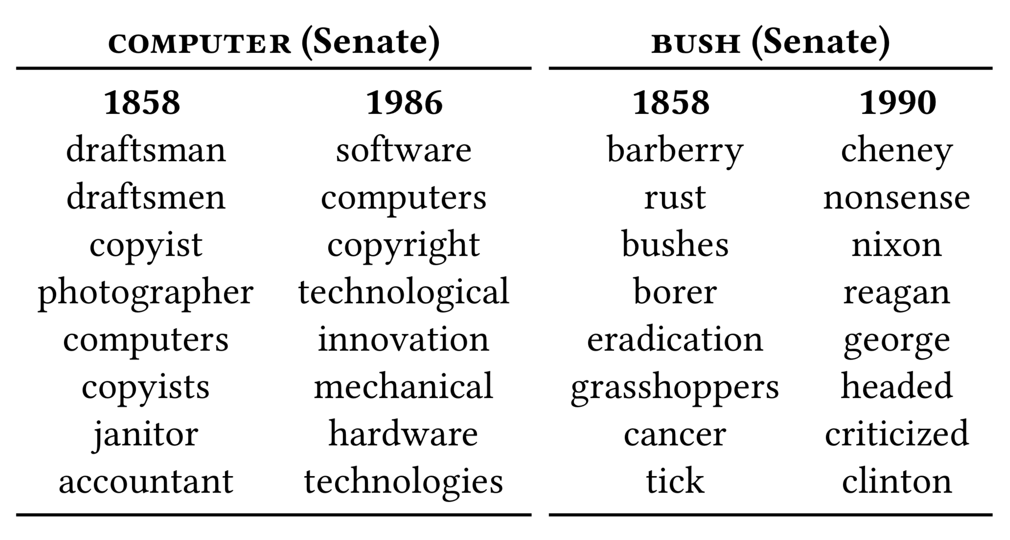
Results

Slide 46
Discussion
Using a probabilistic model enables modeling smooth dynamism phenomenon very easily via using a Gaussian Random Walk prior
Even though this prior seems very proper for shifts on word semantics, it does not work for modeling dynamic behavior in a short period of time, such as modeling patient trajectories

Slide 47
Medical Concept Embedding with Time-Aware Attention
(Xiangrui Cai, Jinyang Gao, Kee Yuan Ngiam, Beng Chin Ooi, Ying Zhang, Xiaojie Yuan, IJCAI, 2018)

Slide 48
Motivation
Previous work on medical concept embeddings misses the temporal nature of Electronic Health Records (EHR)
They ignore time difference between notes
Different medical concepts have different time scopes to be counted as relevant
“common cold” often lasts for weeks, “diabetes mellitus” typically lasts for years
Solution: Model temporal relations by a time-aware attention layer

Slide 49
Methodology
Word2vec CBOW
Slice records per time unit
Apply an attention weight (learned for each concept) when calculating the effect of a context concept on target concept

Slide 50
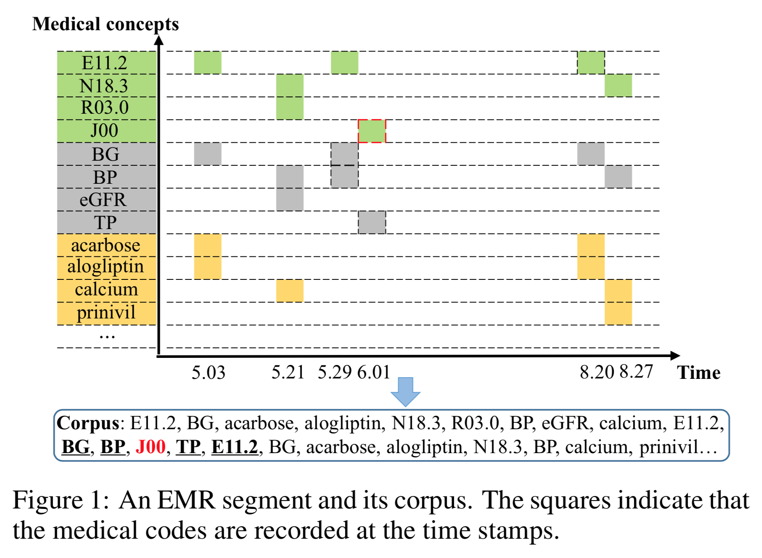
Example
Notes:
Figure 1 illustrates a segment of a patient’s EMR data. Given the window size to be 2, conventional methods equally takeBlood Glucose (BG, May 29), Blood Pressure (BP, May 29),Temperature (TP, Jun 1) and Diabetes mellitus (E11.2, Aug 20) as the contexts of Common cold (J00, May 29). However, the time gap between J00 (Jun 1) and E11.2 (Aug 20) is more than two months, indicating that these two concepts may not be regarded as contexts of each other. Due to irregular visits of patients, this is very common in EMRs.

Slide 51
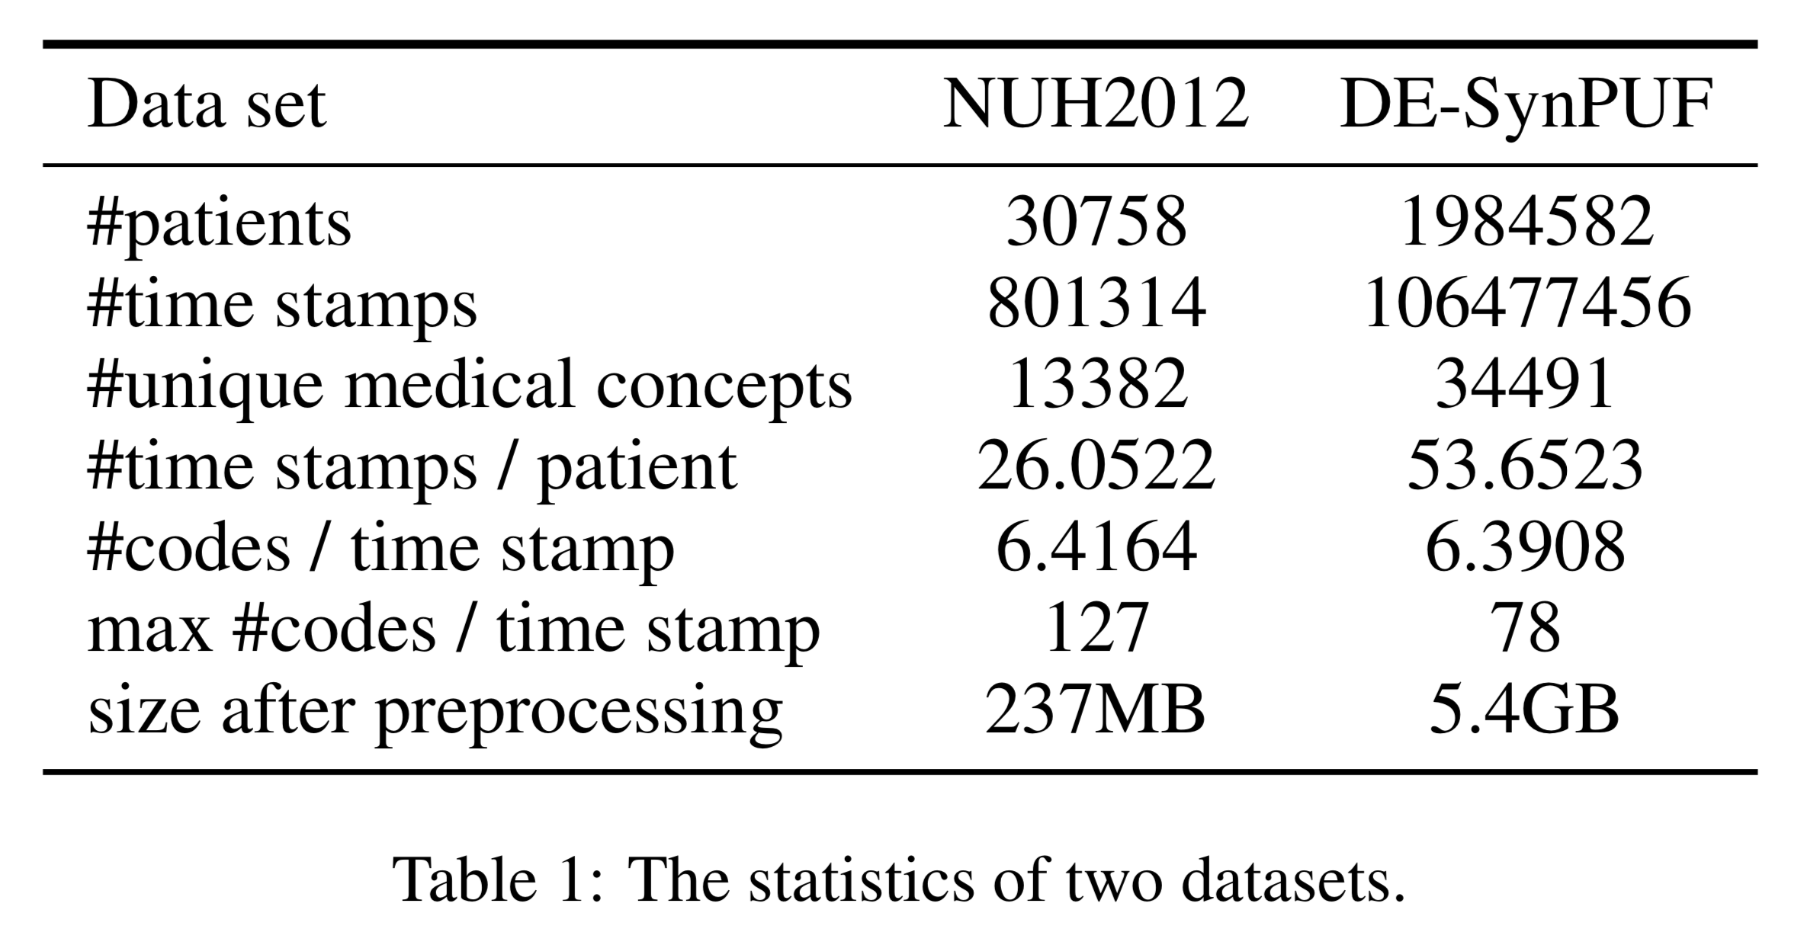
Data

Slide 52
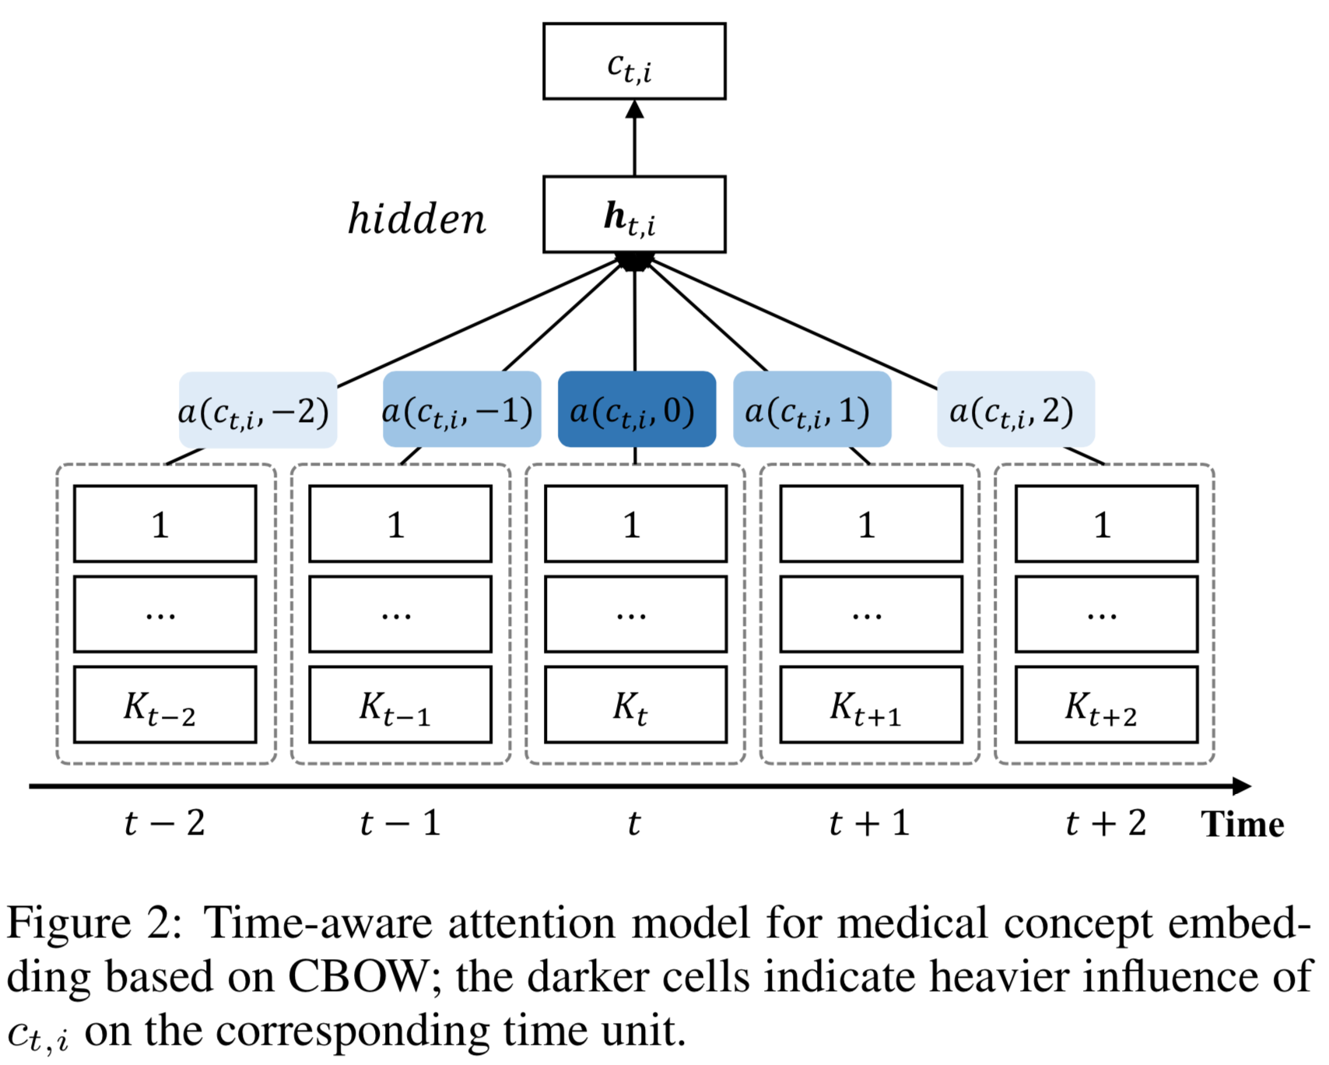
Time-aware attention model

Slide 53
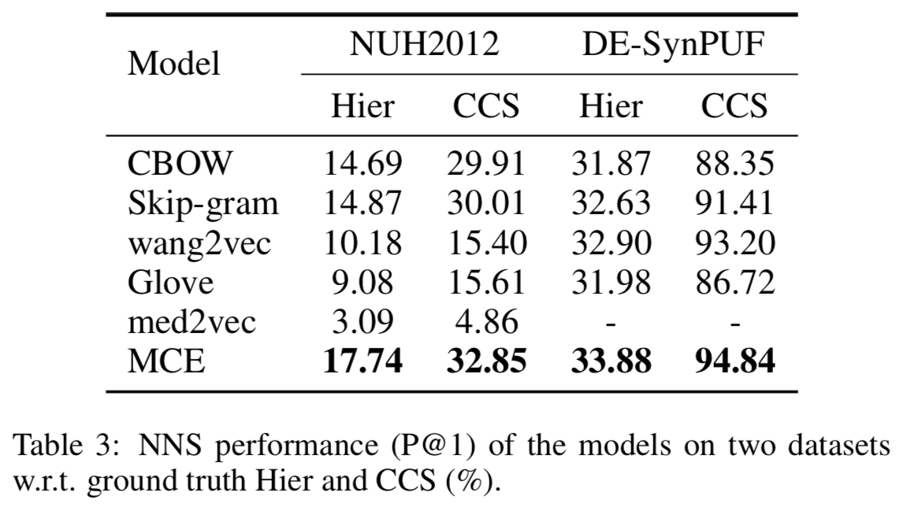
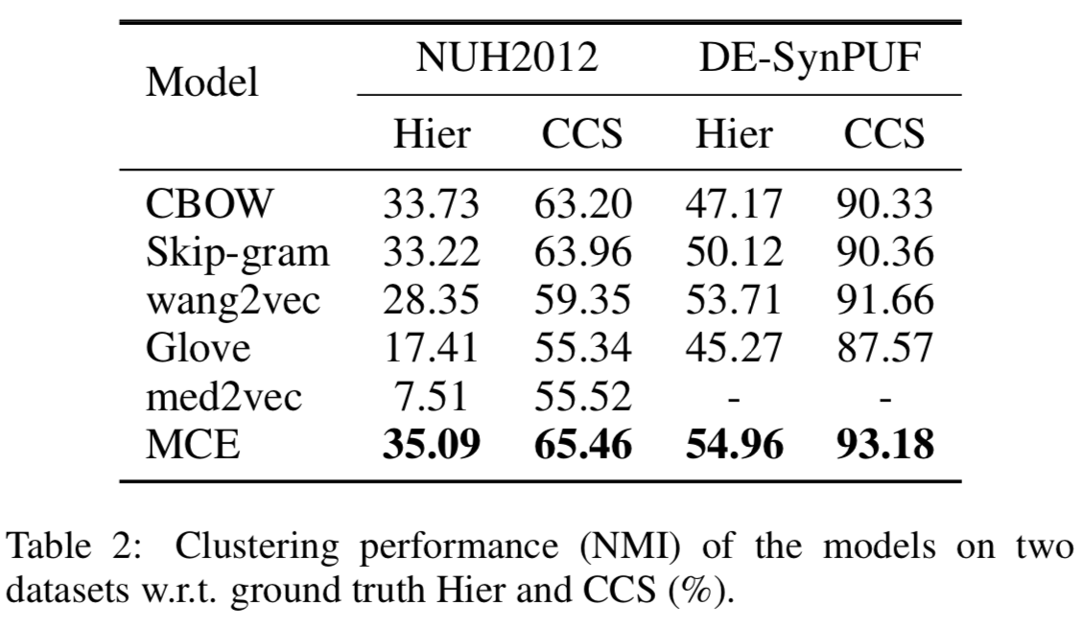
Results

Slide 54
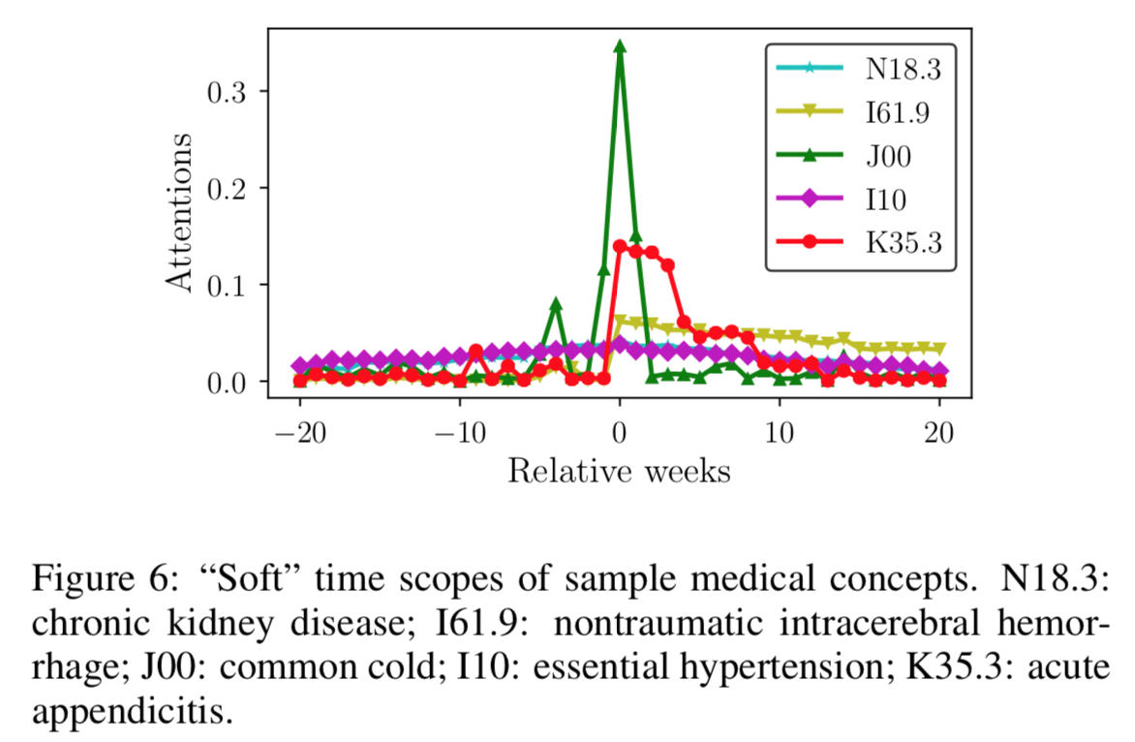
Results: Attention weights

Slide 55
Discussion
Models temporal relation by discretizing time domain, and learning attention weights for each time slice difference
Does not model continuous time relations.

Slide 56
Conclusions
Learning embeddings is STILL an increasingly hot topic in NLP and other domains
Classical embedding techniques are very successful at expressing semantic relations, but have strong assumptions
Ignores polysemy
Ignores semantic changes over time
Ignores temporal nature of learned entities
Dynamic/Temporal embedding techniques try to incorporate that information into model
Learn different embeddings for each time slice over a long time period
Incorporate temporal features of entities to learn the embedding vector for entities
There is promising progress, but still lots of things to do
Modeling temporal relations in continuous domain, rather than discretizing time

Slide 57
Discussion
What kind problems could be modeled by a similar approach?
Can these distributed embedding approaches be applied to any kind of problems?

